Slide 1

6th Grade Accelerated Math
Unit 13, Lesson 10 Equivalent Linear Expressions Volume 2, pg. 314

Slide 2


Benchmark
MA.7.AR.1.2
Determine whether two linear expressions are equivalent.
volume 2, pg. 314

Slide 3
Integrated Mathematical Thinking and Reasoning Standards
MA.K12.MTR.1.1 Actively participate in effortful learning both individually and collectively.
MA.K12.MTR.4.1 Engage in discussions that reflect on the mathematical thinking of self and others.
volume 2, pg. 314

Slide 4

Learning Target
I can verify using substitution that linear expressions are equivalent.
volume 2, pg. 314

Slide 5

Warm-Up
volume 2, pg. 314

Slide 6
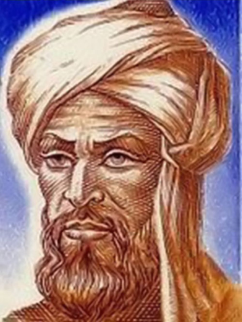
13.10.1 Warm-Up: Origins of Algebra
The word algebra comes from the Arabic word الجبر, or al-jabr, which means, “the restoring of broken parts.” The word algebra comes from the title of a book written by a Persian mathematician named Muhammad ibn Musa al-Khwarizmi in the 9th century.
Based on what you know about algebraic expressions and equations, explain why you think this meaning of the Arabic word makes sense to describe algebra.
volume 2, pg. 314

Slide 7

Refresher
volume 2, pg. 315

Slide 8

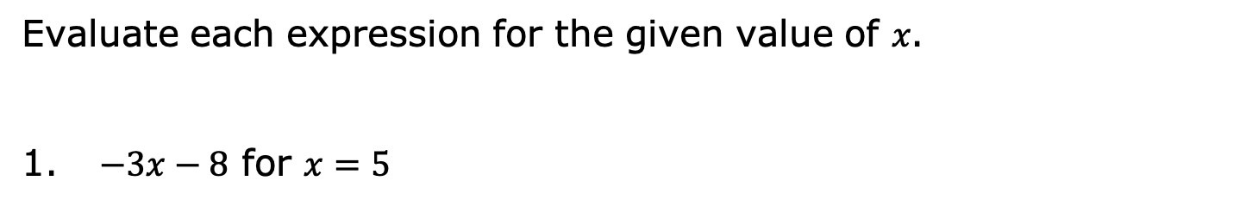
13.10.2 Refresher: Evaluating Algebraic Expressions
Evaluate each expression for the given value of 𝑥.
$−3x−8$ for $x=5$
volume 2, pg. 315

Slide 9

$4−2(x^{2}−7)$for 𝑥=−1
$(4.5+x)∙3$for $x=−\frac{5}{2}$
volume 2, pg. 315

Slide 10

Collaboration
volume 2, pg. 315

Slide 11

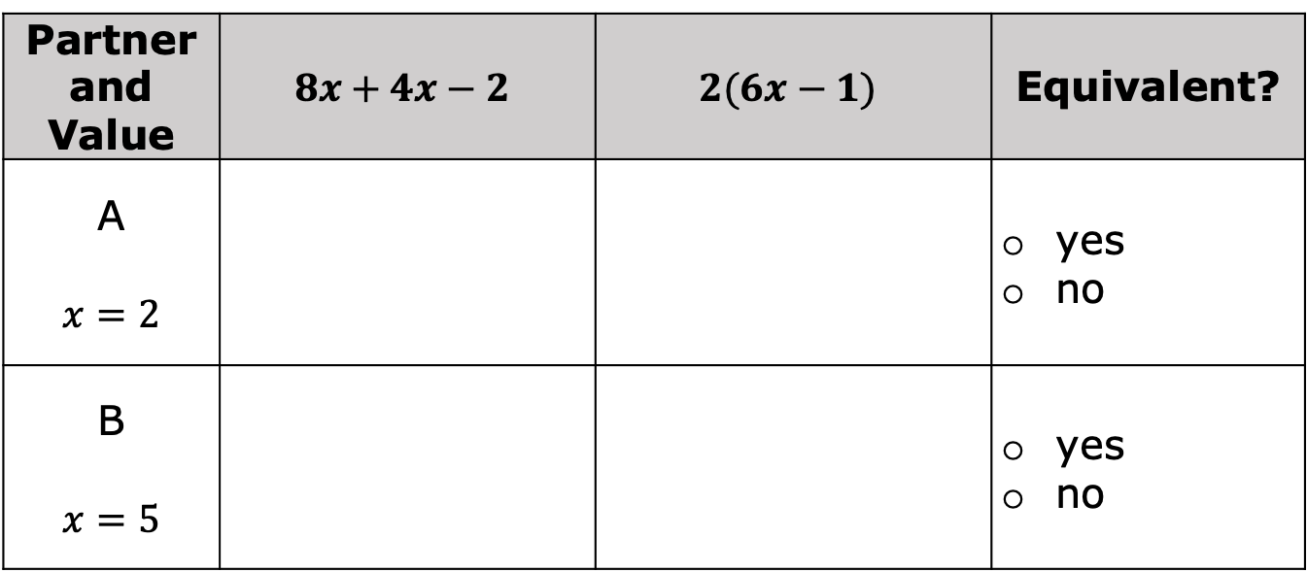
13.10.3 Collaboration: Evaluating Equivalent Expressions Using Substitution
With your partner, complete the table by choosing who will be Partner A or Partner B to determine if the expressions are equivalent.
Partner and Value | $$8x+4x−2$$ | $$2(6x−1)$$ | Equivalent?
A $$x=2$$ |  |  | yes no
B $$x=5$$ |  |  | yes no
volume 2, pg. 315

Slide 12
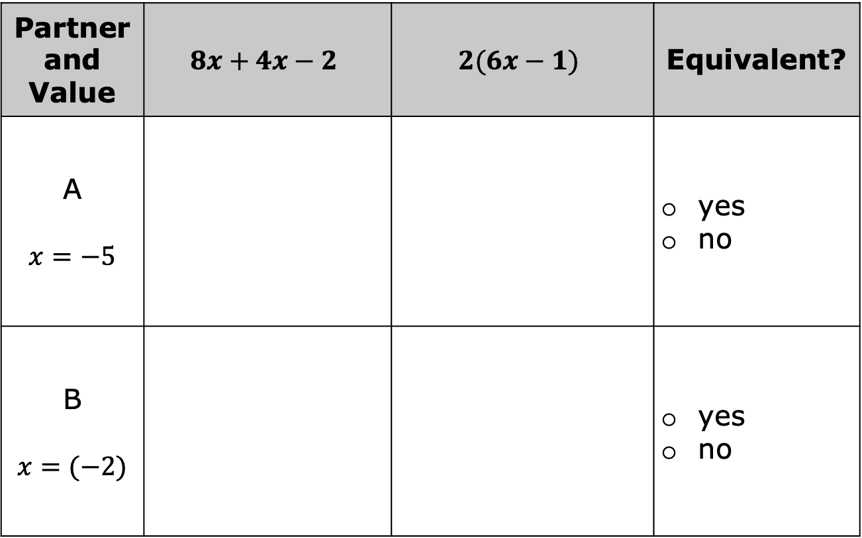
Partner and Value | $$8x+4x−2$$ | $$2(6x−1)$$ | Equivalent?
A $$x=−5$$ |  |  | yes no
B $$x=(−2)$$ |  |  | yes no
volume 2, pg. 315

Slide 13
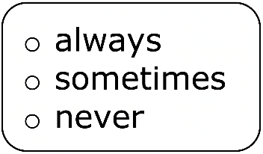
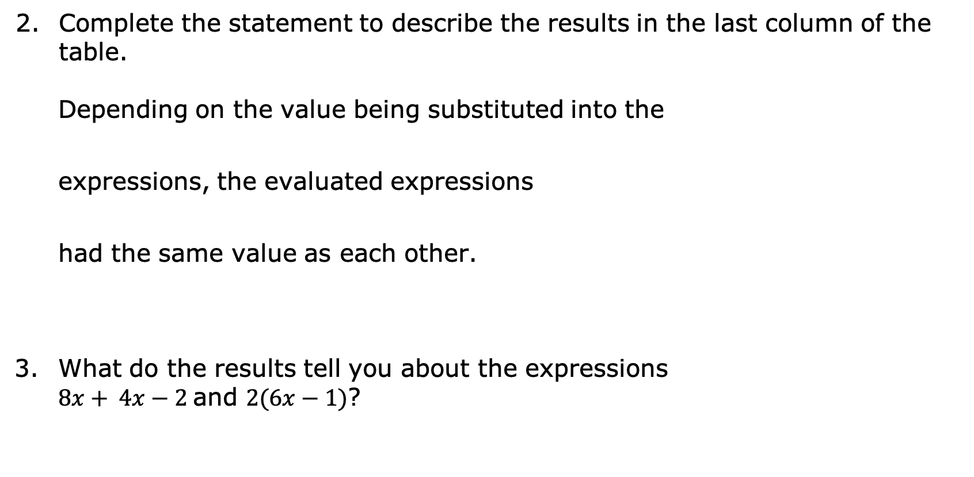
Complete the statement to describe the results in the last column of the table.
Depending on the value being substituted into the
expressions, the evaluated expressions
had the same value as each other.
What do the results tell you about the expressions
$8x+ 4x−2$and $2(6x−1)$?
volume 2, pg. 316

Slide 14

Rewrite $8x+4x−2$ by combining the like terms.
Use the distributive property to rewrite $2(6x−1)$.
Discuss with your partner how the two expressions verify the results from your table.
volume 2, pg. 316

Slide 15

Guided Instruction
volume 2, pg. 316

Slide 16

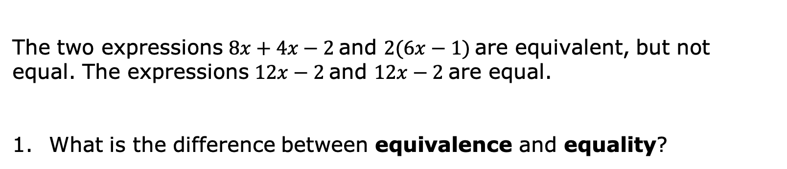
13.10.4 Guided Instruction: Determining Equivalent Expressions Using Substitution
The two expressions $8x+4x−2$and $2(6x−1)$are equivalent, but not equal. The expressions $12x−2$and $12x−2$are equal.
What is the difference between equivalence and equality?
Algebraic expressions are equivalent if they have different terms but are equal when evaluated using the same value for the variables. Algebraic expressions are equal if they have the same terms and operations.
volume 2, pg. 316

Slide 17
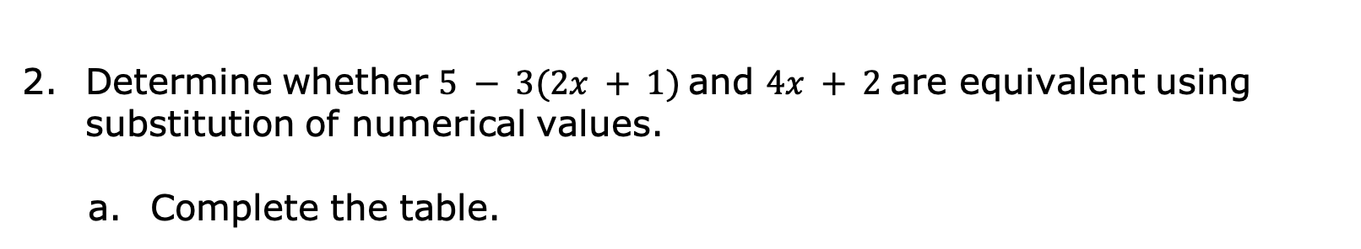
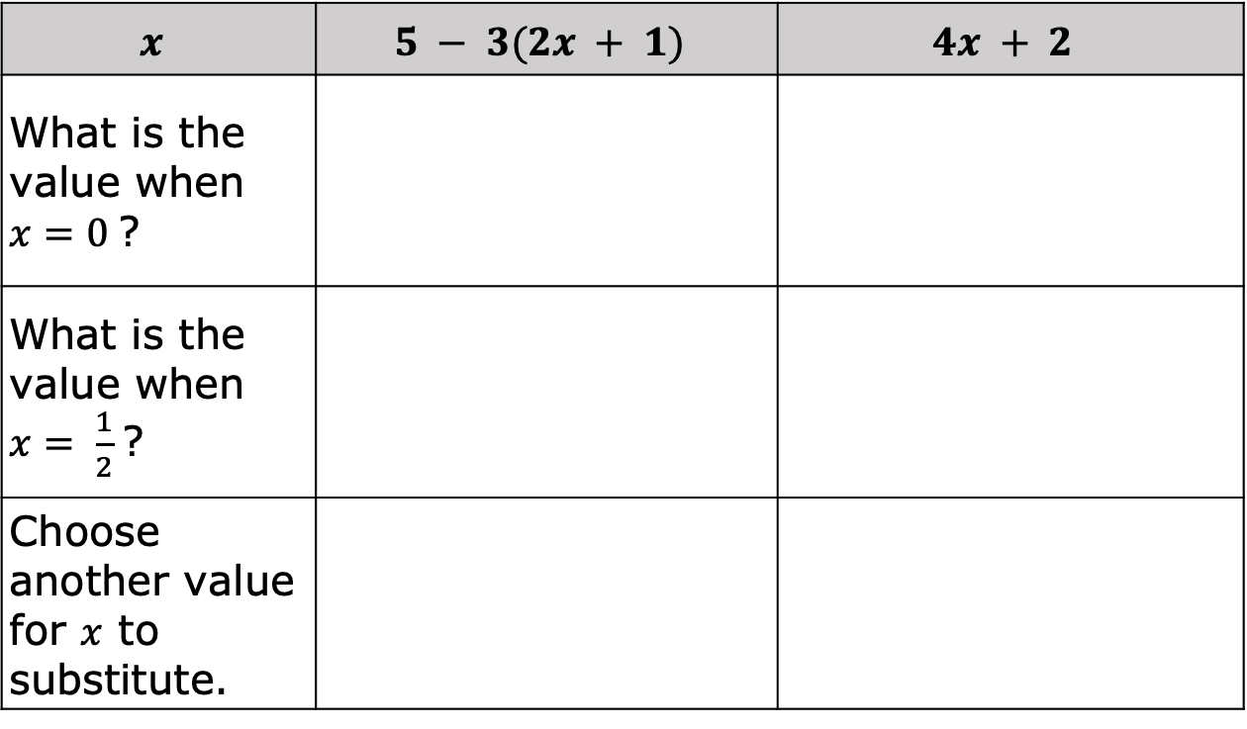
Determine whether $5 − 3(2x + 1)$and $4x + 2$are equivalent using substitution of numerical values.
Complete the table.
$$x$$ | $$5 − 3(2x + 1)$$ | $$4x + 2$$
What is the value when $x=0$?
What is the value when $x= \frac{1}{2}$?
Choose another value for $x$ to substitute.
volume 2, pg. 317

Slide 18
Explain if the expressions are equivalent.
volume 2, pg. 317

Slide 19
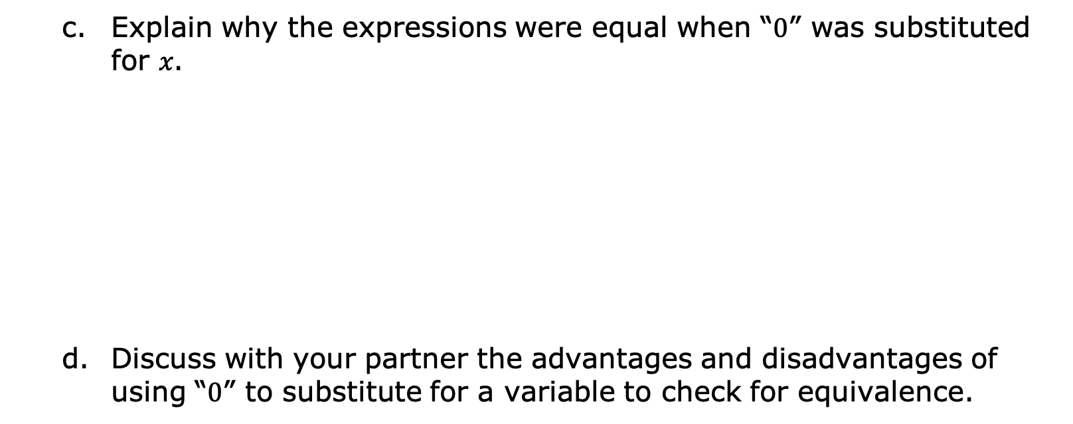
Explain why the expressions were equal when “$0$” was substituted for 𝑥.
Discuss with your partner the advantages and disadvantages of using “$0$” to substitute for a variable to check for equivalence.
volume 2, pg. 317

Slide 20
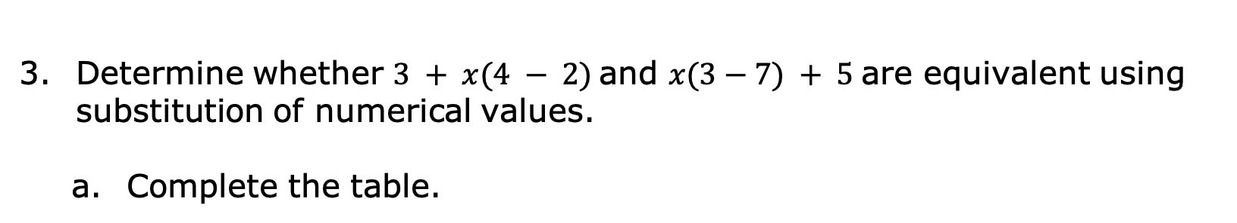
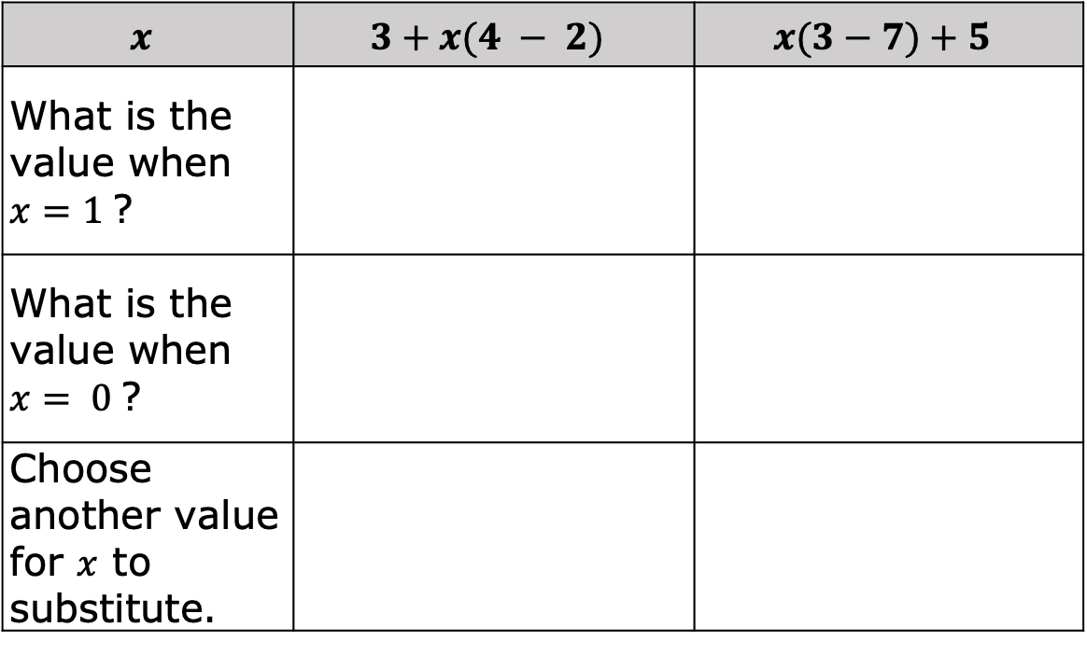
Determine whether $3 + x(4 − 2)$and $x(3−7) + 5$are equivalent using substitution of numerical values.
Complete the table.
$$x$$ | $$3+x(4 − 2)$$ | $$x(3−7)+5$$
What is the value when $x=1$?
What is the value when $x= 0$?
Choose another value for $x$ to substitute.
volume 2, pg. 318

Slide 21
How many values are best to use when substituting values in for the variable to check for equivalency?
volume 2, pg. 318

Slide 22

Guided Practice
volume 2, pg. 318

Slide 23

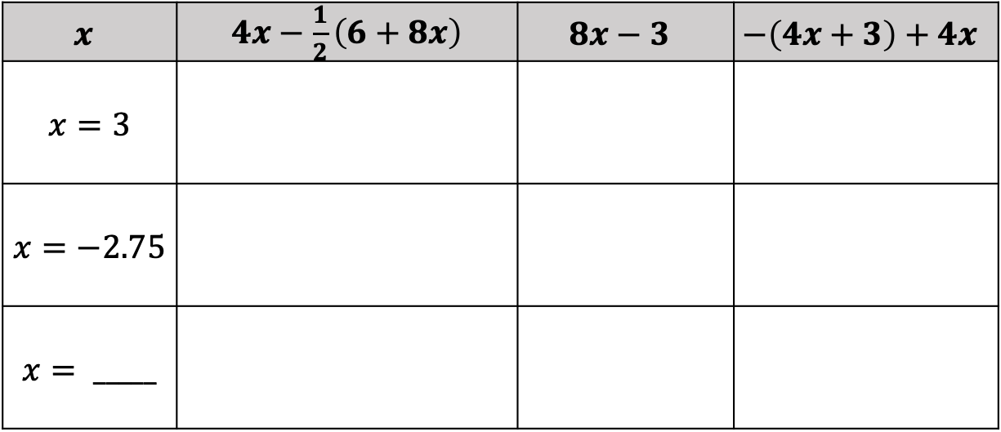
13.10.5 Guided Practice: Determining Equivalent Expressions Using Substitution
Consider the three expressions below. Determine whether the expressions are equivalent by substituting the given value of 𝑥.
Complete the table.
$$x$$ | $4x−\frac{1}{2}\left(6+8x\right)$ | $$8x−3$$ | $$−\left(4x+3\right)+4x$$
$$x=3$$
$$x=−2.75$$
$$x= _____$$
volume 2, pg. 318

Slide 24
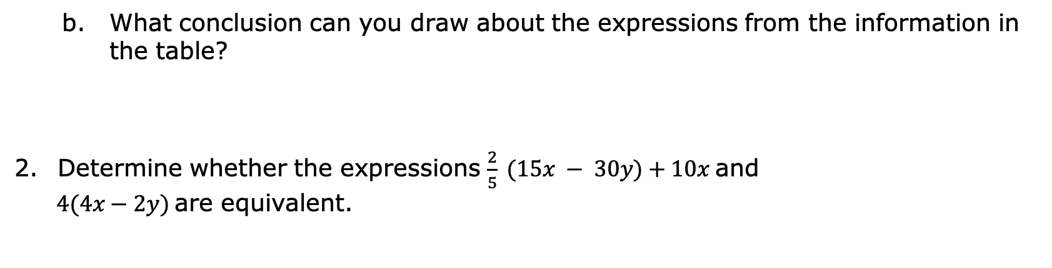
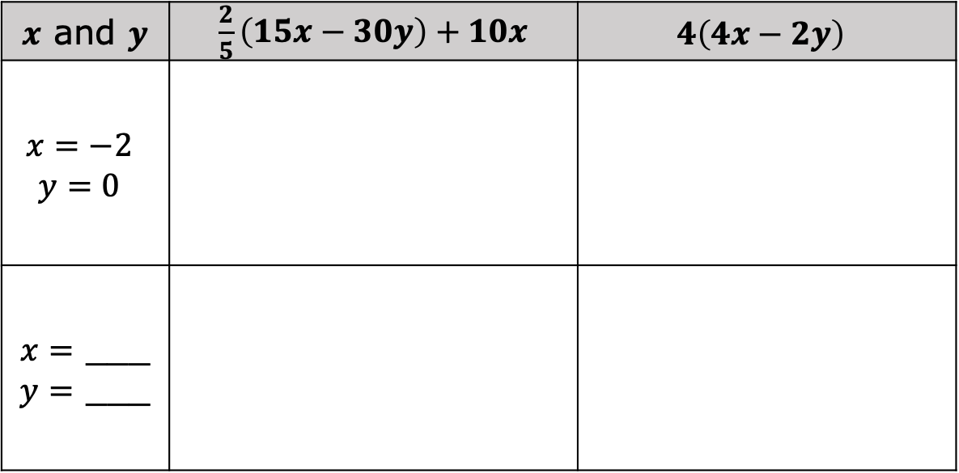
What conclusion can you draw about the expressions from the information in the table?
Determine whether the expressions $\frac{2}{5} (15x − 30y)+10x$and
$4(4x−2y)$are equivalent.
$x$ and $y$ | $\frac{2}{5}\left(15x−30y\right)+10x$ | $$4\left(4x−2y\right)$$
$$x=−2$$ $$y=0$$
$x=$ ___ $y=$ ___
volume 2, pg. 319

Slide 25

Your Turn
volume 2, pg. 319

Slide 26
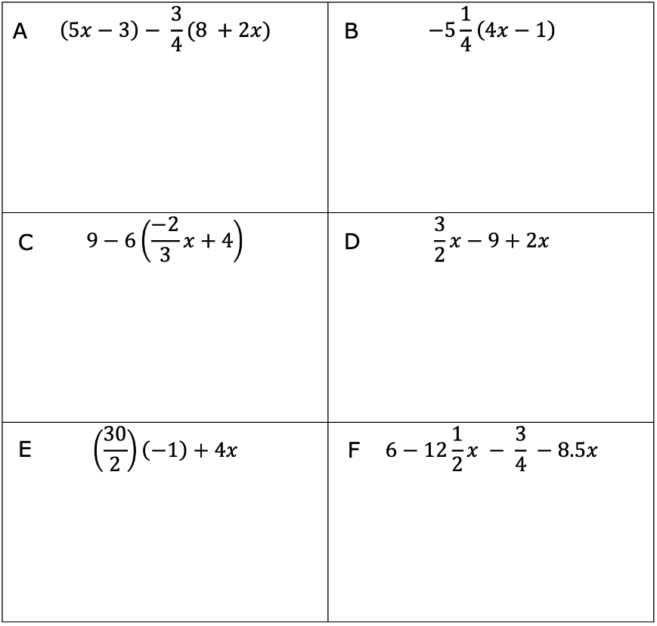
13.10.6 Your Turn!
Determine which expressions are equivalent by substituting the same values for the variable.
volume 2, pg. 319

Slide 27
Complete each statement using the expressions from the table.
_________________ is equivalent to _________________
_________________ is equivalent to _________________
_________________ is equivalent to _________________
volume 2, pg. 319

Slide 28

Wrap-Up
volume 2, pg. 320

Slide 29
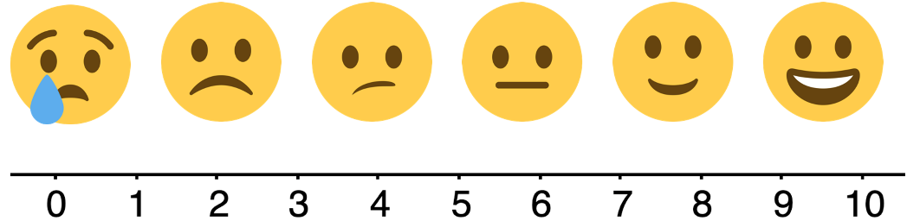
13.10.7 Wrap-Up: Reflection
Rate yourself using the scale below on today’s learning target.
I can verify using substitution that linear expressions are equivalent.
Write an explanation of why you rated yourself where you did.
volume 2, pg. 320

